Slide 1
Welcome to VHA
Boost Mobile Authorized Retailer

Slide 2
Agenda
Why Boost Mobile
  For consumers
  For commission
  For your business
SPG Sales Portal
  How to register on the Sales Portal
  How to make a sale/activate on the SPG portal
  Coach’s corner on maximizing new activation sales
The VHA Dealer portal
  How to make an order on the portal
  How to Create an RMA
  Reporting + Eureka payments
Marketing
  Marketing resources
  Coach’s corner on effective marketing
  Coach’s corner on maximizing replenishment transactions
Communication
Eureka training

Slide 3
WHY BOOST MOBILE?

Slide 4
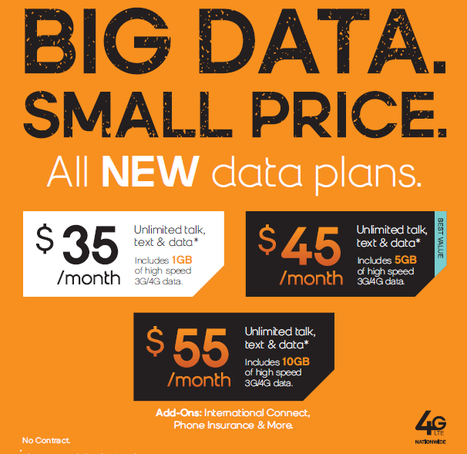
Boost Mobile for your customers
Get more unlimited: 3 unlimited rate plans to choose from (average user = 1.2GB data)
More simplicity: Pick any phone on any plan
Peace of mind: New phones come w/ 1 year warranty & option for insurance

Slide 5
Get Paid: No charge backs!
New Activation pay-out: (based on rate plan chosen at point of sale)
(get paid more for Boost & Virgin Mobile plans $45.00 and higher)
Replenishment: 5% for Boost & Virgin Mobile top-ups
(ex: take $20,000 in payments & earn $1,000)
Handset Margin: Average $28 per box & up
(ex: purchase handset at $72 wholesale & sell it for $99.99 retail)
Timing | $30 – $44.99 | $45+
Up front (guaranteed) | 75% | 75%
1st month top up | NA | 25%

Slide 6
Boost Mobile for your business
(Commission plan effective June 1st)
Earn more money upfront
Get paid for the Activation, Handset, Add-ons, & Top-up
Peace of mind w/ warranty support & RMA options
New Activation commission on $45 plan & a android smart phone (without any add-ons)
Item | Upfront | Month 1 | Total payout
Activation | $33.75 | $11.25 | $45
Handset Margin | $28 | - | $28
Payment (5%) | $2.25 | $2.25 | $4.50
TOTAL $ | $64 | $13.50 | $77.50

Slide 7
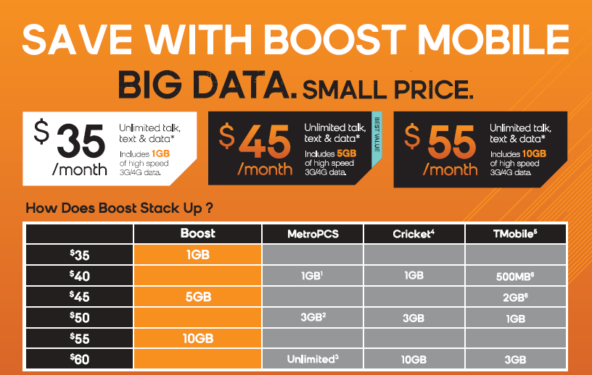
WIN with Boost Mobile!

Slide 8
SPG Sales Portal

Slide 9
How to Register for the SPG Sales Portal
Sprint Prepaid Group will auto-register new locations for the SPG Sales Portal
AND Email Authorized Retailers the Login Credentials for the newly created
SPG Sales Portal account. (check your email on file w/ Boost Mobile, & check spam
or junk mail folder in case it cannot be found in your inbox)
Visit:
www.boostmobilesales.com

Slide 10
Things to Remember
  The Store Manager Login is used to set up and maintain users (e.g. Store Employees) on the Sales Portal
  (store manager login will not have access to activate phones)
  Upon registration, you will receive an email letting you know that you are ready to get started, how to set up users, & change passwords using your Store Manager Login.
  Add additional users so that there is access to activate and go into customer accounts

Slide 11
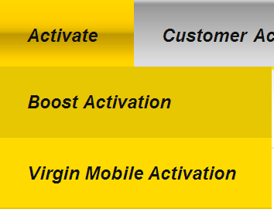
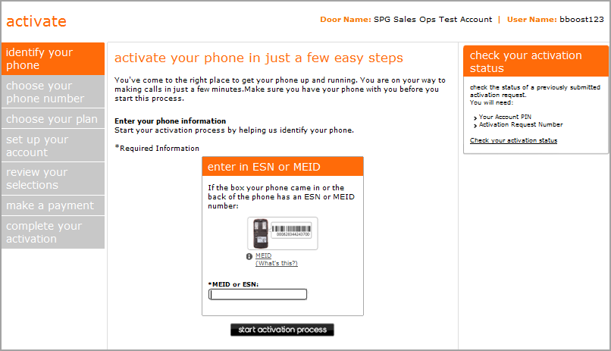
Activating Boost Mobile Devices via Sales Portal
Step 1:
Log in to the SPG Sales Portal at www.boostmobilesales.com
Step 2:
Move your cursor over Activate and select Boost Mobile Activation.
NOTE: Only Individual User accounts are able to perform an activation using the Sales Portal.
Step 3:
The activation landing page appears.

Slide 12
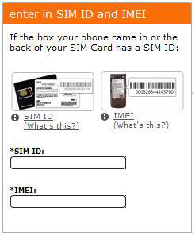
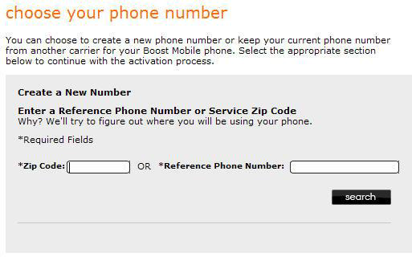
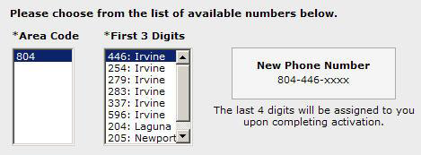
Activating Continued…
Step 4:
Enter the equipment identifier information:
Enter the ESN or MEID (for iPhones MEID can be entered in HEX format)
Devices with a removable UICCID SIM will require the 20 digit UICCID entry
Step 5:
Click the Start Activation Process button. The Choose Your Number screen appears.
NOTE: When activating a previously activate Boost Mobile device, your customer will need to pay a $10 reactivation fee. Service will NOT be active until amount has been paid.
Step 6:
Enter the requested information for creating a new number:
Enter the desired service zip code or reference phone number.
Step 7:
Click the Search button. Additional options appear below for selecting the area code and prefix.

Slide 13
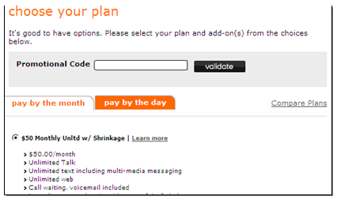
Activating Continued…
Step 8:
Click Continue. The Choose Your Plan screen appears,
Click to select the tab corresponding with the desired payment frequency (pay by the month or pay by the day). The plan options are displayed below.
Step 9:
When processing the customer’s activation in the Choose Plan Screen the You May Be Eligible for Handset Insurance popup screen appears.
Step 10:
The Personal Information Section appears.
Enter the following information in the Personal Information section:
First Name
Last Name
Address Line 1
Address Line 2
City
State
Zip Code
Email Address
Confirm Email Address

Slide 14
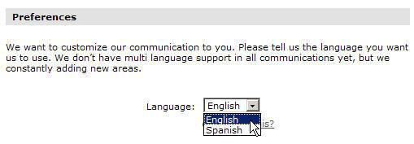
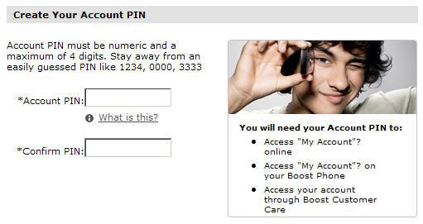
Activating Continued…
Step 11:
In the Preferences section, select the desired language from the Language drop-down menu.
Step 12:
In the Create Your Account PIN Section, type the account PIN in the Account PIN field.
Click Continue button.
Skip the next & proceed to the
the Review Your Selections Sections
NOTE: The pin should not have repeating or consecutive digits or be easy to guess

Slide 15
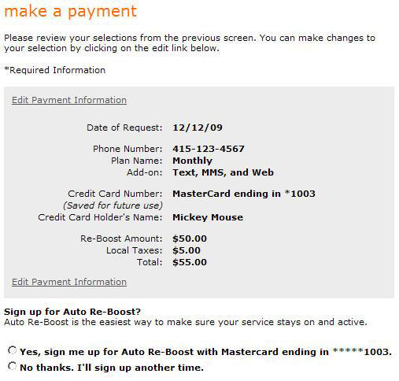
Activating Continued…
Step 16:
Click the Continue button. A summary of the payment information appears. Then once information is confirmed
The congratulations screen appears.
Post Activation Steps
*Very Important* To begin processing additional new activations, you will need to close out the browser window and repeat the complete process starting with Step 1.
Once you have closed the browser window, move your cursor over Activate and select Boost Activation to activate additional handsets.

Slide 16
For additional information on activating a Boost Mobile Phone – Please visit:
https://www.boostmobilesales.com/boost-sales-portal/docs/Activate%20Boost%20Mobile%20Devices%20via%20Sales%20Portal%20070611.pdf

Slide 17
VHA Dealer Portal

Slide 18
VHA Dealer Portal
-Place orders from anywhere with internet
-Track status of an order
-See availability of inventory
-See & apply available credits
-See invoice & transaction history
-Create an RMA
-See recent communications & news
-Make wallet loads, Pay NSFs, deposit additional funds into your ePay account
-Commission reporting

Slide 19
How to Make an Order on Dealer Portal
http://www.youtube.com/watch?v=oyTR1WBzjCc&feature=player_embedded

Slide 20
How to Create a RMA
http://www.youtube.com/watch?v=UWjTU7hL3Ms&feature=player_embedded
Notes:
RMA’s can be created from the VHA dealer portal

Slide 21
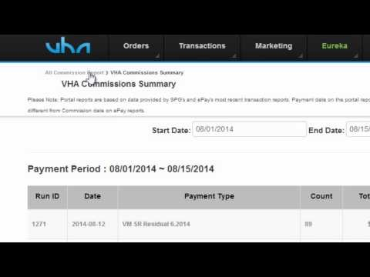
Commission Reporting

Slide 22
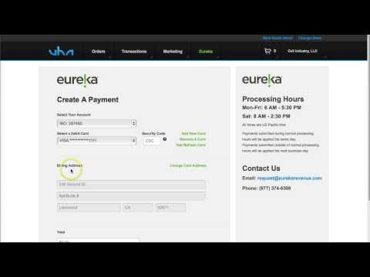
Eureka Payment Portal

Slide 23
Registering for the payment portal
1) Log onto the VHA Dealer Portal – www.vhacorp.com
2) Select the store location to apply a payment
3) Click on Eureka > Make Eureka Payment > Add New Card
4) Select Debit Card Brand type & enter in your Debit Card info
5) Click on Add Card > Enter Billing Address & Total amount to add
6) Click Submit Payment & wait for Payment confirmation pop-up
7) An email confirmation will be sent to your registered email!
http://youtu.be/N1C3PmTbglU Click here for the training video:

Slide 24
Eureka Payment Portal
Enables you to:
Save trips to the Bank
Increase your available credit to process payments
Pay for NSFs, Wallet Loads, or Security Deposits
Access at anytime

Slide 25

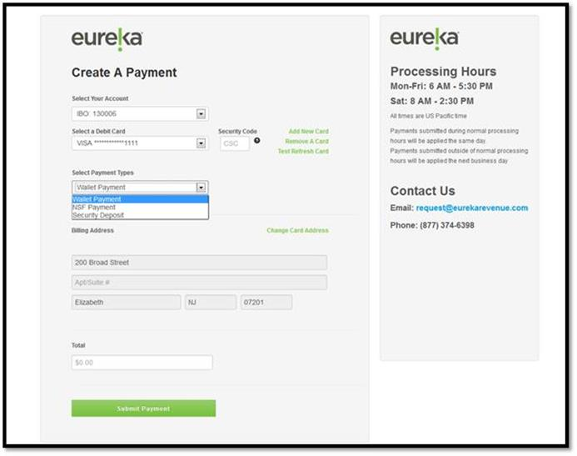

Slide 26
If you have any questions, concerns, and/or comments, please contact your Inside Account Manager at (800) 404-3063.

Slide 27
Marketing

Slide 28
Growing Your Business
Websites You Need To Know for Marketing
SPG Ad Builder
SPG Goods
VHA Marketing
  Marketing Initiatives
  Creative Requests
  VHA Payment Rewards Card Program

Slide 29
SPG Ad Builder
Link – www.spgadbuilder.com
Purpose: This website will allow you to create and/or download SPG approved marketing materials to help your business drive traffic
  Flyers
  Direct Mailer pieces
  Posters
  Transit Ads
  Radio Scripts
  Note: If you would like to create any “new” materials, you will need approval from your SPG Rep and/or contact your VHA Account Manager – allow at least 6 weeks for an approval

Slide 30
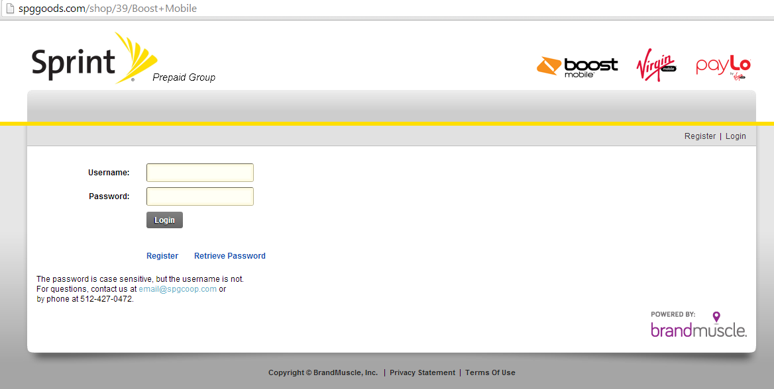
SPG Ad Builder
Link – www.spgadbuilder.com
How to get access: Click on the REGISTER button and complete registration form. Only SPG Authorized Retailers will be granted access – allow 2 business days.

Slide 31
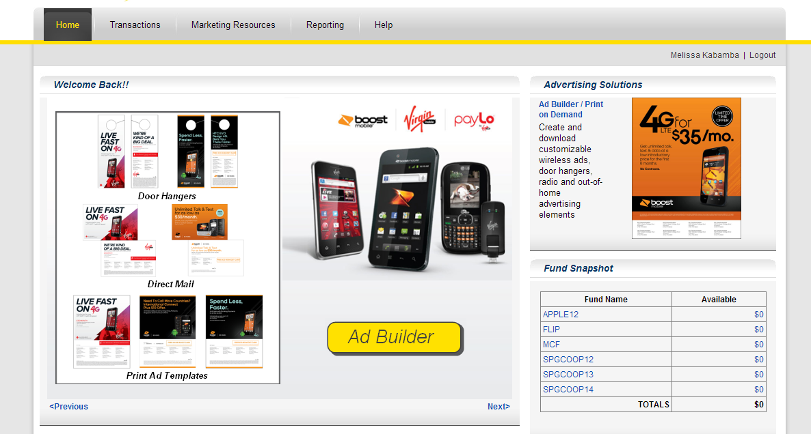
SPG Ad Builder
Link – www.spgadbuilder.com
Simply click on the Ad Builder icon to begin!
Print-on-demand allows you to order directly from SPG

Slide 32
SPG Ad Builder
Link – www.spgadbuilder.com
Simply click on the Ad Builder icon to begin!
Print-on-demand allows you to order directly from SPG

Slide 33
SPG Goods
Link – www.spggoods.com
Sprint Prepaid Goods is your official source for Boost Mobile and Virgin merchandise and retail marketing support.
  Displays
  Signs
  Shirts
  Promo Items
  Many more marketing items

Slide 34
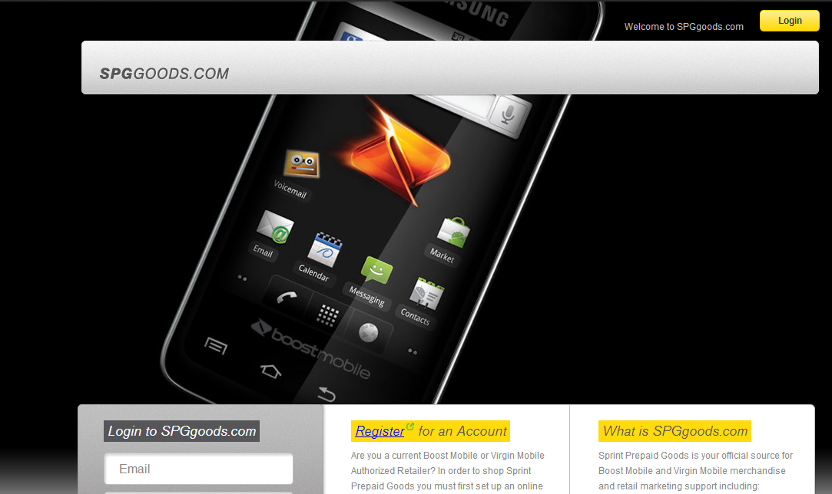
SPG Goods
Click “Register” and complete form to get access to the site. It will take 2 business days for processing.

Slide 35
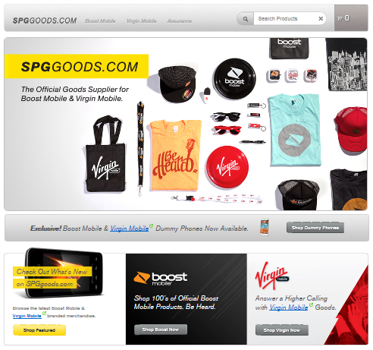
SPG Goods
Stop traffic with promotional items that are available on the SPG Goods site.
  Displays
  Signs
  Shirts
  Flex Blades
  Banners
  Tents
  Promo Items
  Many more items

Slide 36
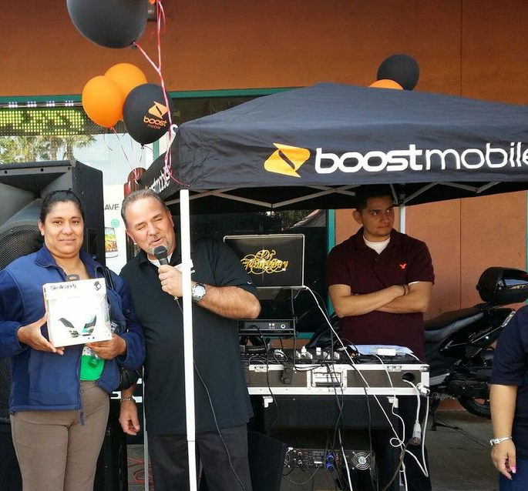
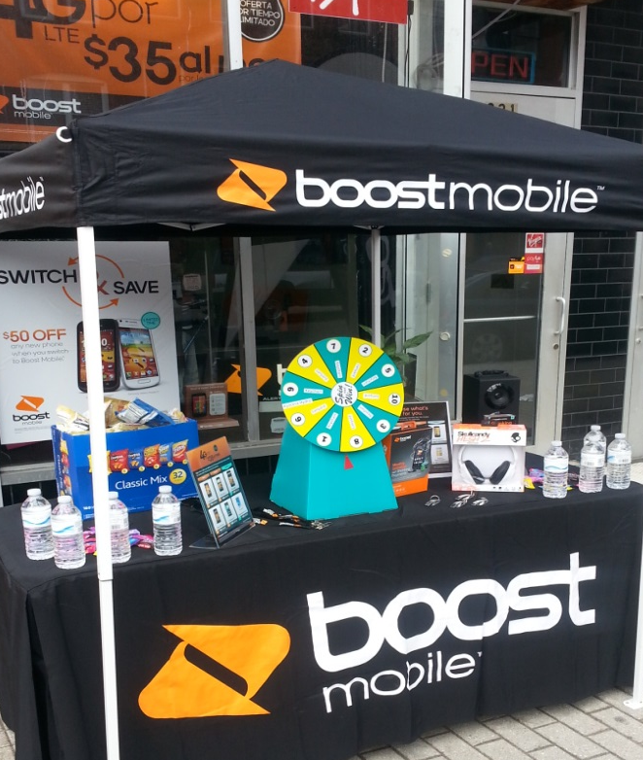
VHA Marketing
VHA offers marketing campaigns that are subsidized to help our dealers grow their business. We promote marketing campaigns through email and your VHA Account Managers. Here are just a few of the marketing initiatives to bring traffic into your door:
Tent Events
Direct Mail
Flyer Distribution
Sign spinners
And More!

Slide 37
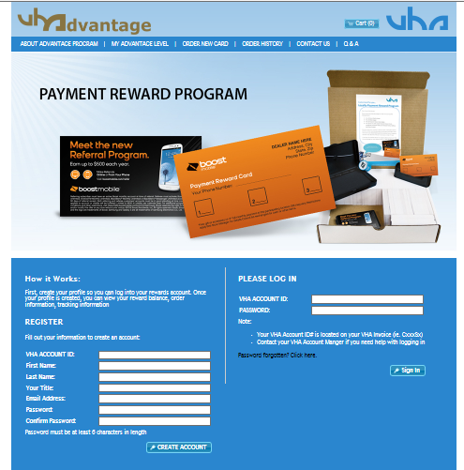
VHA Payment Reward Card Program
You’ve got a new customer signed up! Now what? Keep them coming back, and get a referral from them with the VHA Payment Reward Card Program.
Link: www.vharewards.com
“Register” by completing the form to get access to the site. It will take 2 business days for processing.

Slide 38
VHA Payment Reward Card Program
  The VHA payment reward card program encourages customers to come back to your location to top-up.
Kit includes:
  1,000 Loyalty Reward Cards with customize dealer info (name, address, phone. The design on card changes periodically)
  1 Boost Mobile Stamp
  1 Black Inkpad
  1 Payment Reward Card Holder
  All orders submitted and paid through the ordering website will be processed within 3-5 business days. After the order is processed, you should expect to receive your kit within 5-7 business days shipped via UPS Ground.

Slide 39
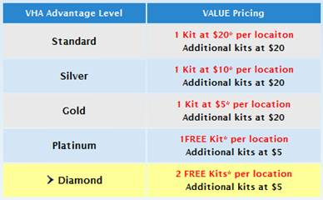
VHA Payment Card Program
  Messaging on card:
  Front side - Free gift or accessory provided by dealer on 3rd monthly payment
  Back side – Quarterly promotional messaging
  Popular handset selling points, Boost Mobile referral program, and much more (promotional messaging & art work update quarterly)
Cost:
Pricing is based on the VHA Advantage Level and total kits ordered in the calendar year 2014. The system will reflect what tier they currently are on when signing in on the home screen.

Slide 40
VHA continues to look for opportunities to grow your business. We value your feedback and concerns.
Email marketing@vhacorp.com

Slide 41
Communication

Slide 42
Get the 411
VHA and Sprint Prepaid Group provides great newsletters to dealers with updates on all promotions and best practices. The most current newsletters can be found via the Dealer Sales Portal.
VHA Prepaid News
  Updated on the 1st of each month w/ latest promotions, updates, & current wholesale & suggested retail handset pricing
The Beat Newsletter brought to you by SPG
  Two editions during the month. Typically one at the beginning and another towards the end.
VHAdvisor Best Practices for dealers updated during the 1st week of each month
Updates via Email
  There will be times during the month where SPG or VHA have updates to promotions or operations. VHA will notify dealers within 48 – 72 business hours of any changes that will impact our dealers and their customers.

